Slide 1
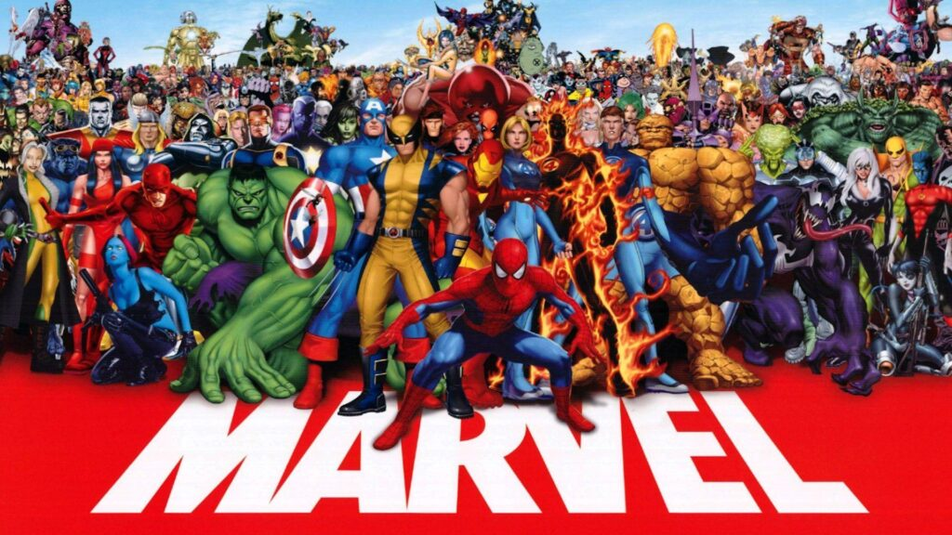

Marvel Personality Test
Team Members:
Mark Powers
Brendan Noall
Brandon Briggs
Alejandro Marcovich
Date: 05/03/2023

Slide 2
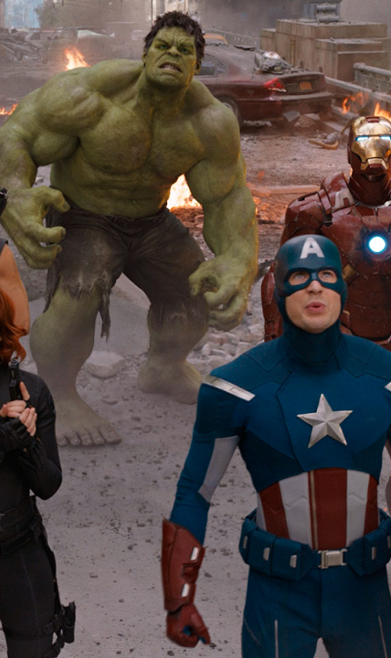
Purpose of Project Create a Myers-Briggs personality website tailored around Marvel Characters
Why was this a good fit?
Agile methodology emphasizes collaboration, customer feedback, and the ability to respond to changing requirements
Iterative nature allowed for continuous refinement and improvement
Involved multiple stakeholders
Prioritization of features and functionality
Marvel Fandom/Experience with personality test
Combined interest in a unique way
Valuable and engaging resource for Marvel fans
Why were we interested?
Notes:
This project was a good fit for Agile because it involved multiple stakeholders, including our team as the developers, Marvel fans who would be using the website, and the Marvel universe itself, which provided the source material for the website's content
The iterative nature of Agile allowed us to continuously refine and improve the website based on feedback from stakeholders, rather than trying to deliver a fully polished product all at once
The use of Agile allowed us to prioritize features and functionality based on their importance to stakeholders, rather than trying to deliver everything at once and potentially missing the mark on what was most important
Interest talking points
Fans of personality tests and find them to be a valuable tool for self-reflection and personal growth
Similarly, we are fans of the Marvel universe and find it to be a rich source of inspiration for storytelling and character development
This project combined both of these interests in a unique and exciting way, making it particularly appealing to us
We were excited to explore how different Marvel characters might fit into different Myers-Briggs personality types, and to create a website that would allow others to do the same

Slide 3

Project Goals
Create
Create a Marvel personality website that uses Myers-Briggs Type Indicator (MBTI) to match users with Marvel characters that share the same personality type.
Develop
Develop a website that engages Marvel fans and personality test enthusiasts by providing an interactive and fun experience.
Utilize
Utilize Agile methodology, specifically SCRUM, to manage the project in a structured way and ensure it is completed on time and within budget.
Use
Use sprints and burndown charts to track progress and ensure that the website is developed iteratively, with continuous feedback and improvement.
Notes:
The website will feature a homepage with 25 personality-based questions that will determine the user's MBTI type. Once the user has answered all questions, they will be taken to another webpage that will show their MBTI type and a Marvel character that shares the same type. The website will also showcase non-Marvel characters with the same MBTI type.
The website aims to provide a fun and engaging experience for both Marvel fans and personality test enthusiasts. The user will be able to learn more about their MBTI type and how it relates to the Marvel universe. The website will provide a unique way for users to engage with Marvel characters and potentially discover new characters that share their personality type.
SCRUM will be used to manage the project in a structured way and ensure it is completed within the given timeline and budget. Using SCRUM will allow the team to break down the project into sprints, each consisting of specific tasks that will be completed within the given time frame. SCRUM will enable continuous feedback and improvement throughout the development process.
The development of the website will be done in sprints, with each sprint having a specific goal and set of tasks to complete. Burndown charts will be used to track progress and ensure that the team is on track to meet the project's timeline and budget. The iterative nature of Agile methodology will allow for continuous feedback and improvement, ensuring that the website meets the needs and expectations of the users.

Slide 4
Project Function
Concept of Operations
The user would first log onto Marvel.lmu.build
The user would than answer 25 MBTI questions.
The site redirects the user to the correlating personality page and Marvel character based off the where the user landed in each category.
User has option to retake the exam.
Planned System Data Flow
User inputs into a question, the user's input is divided into for different categories.
Each category similar to an integer variable.
After each response from the user, the inter variables that represent each category would increase.
After user hits submit, the integer variables would be compared to the 16 different result pages which have 4 conditions each.
Once results match a results page conditions, the users is redirected, and user submission counter is increased.

Slide 5
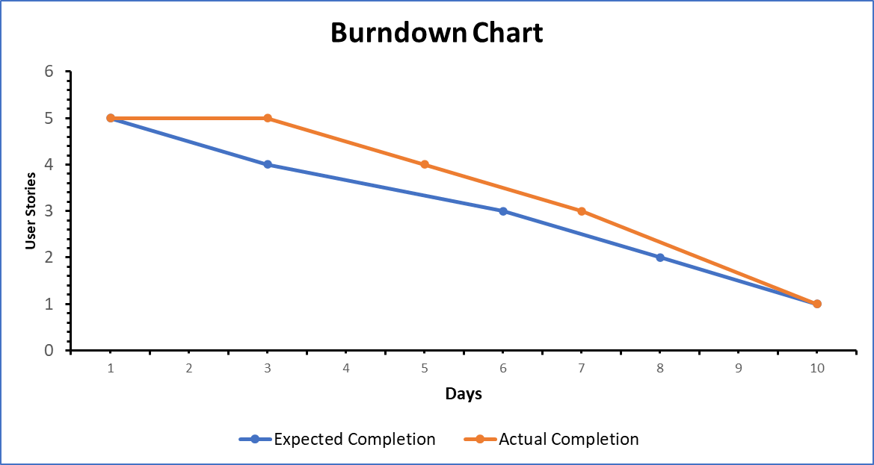
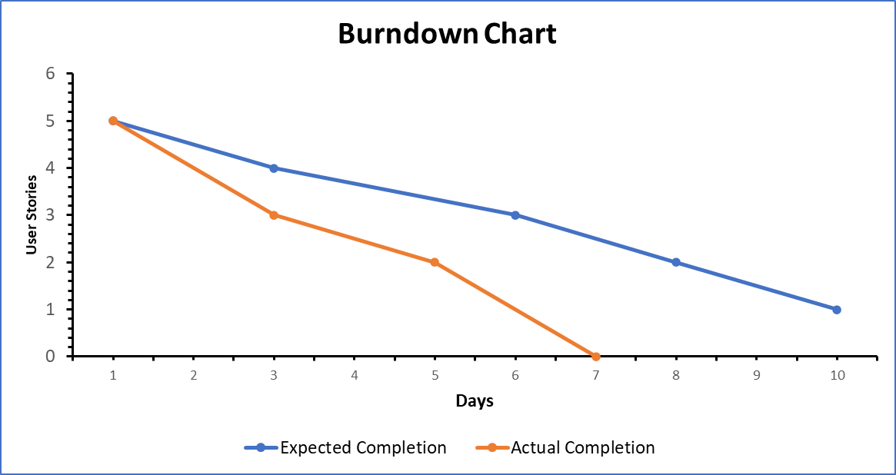
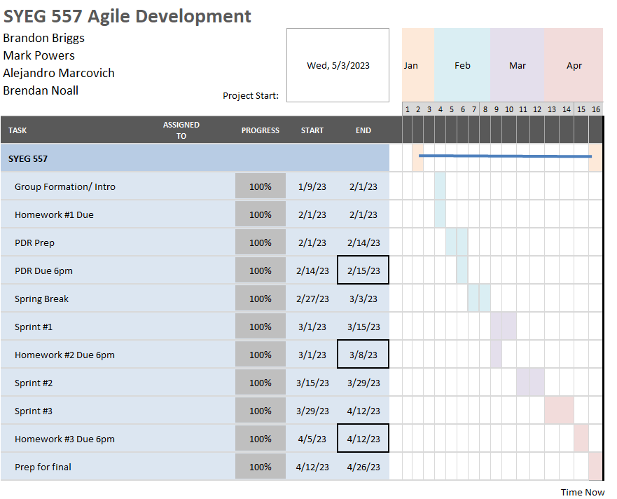
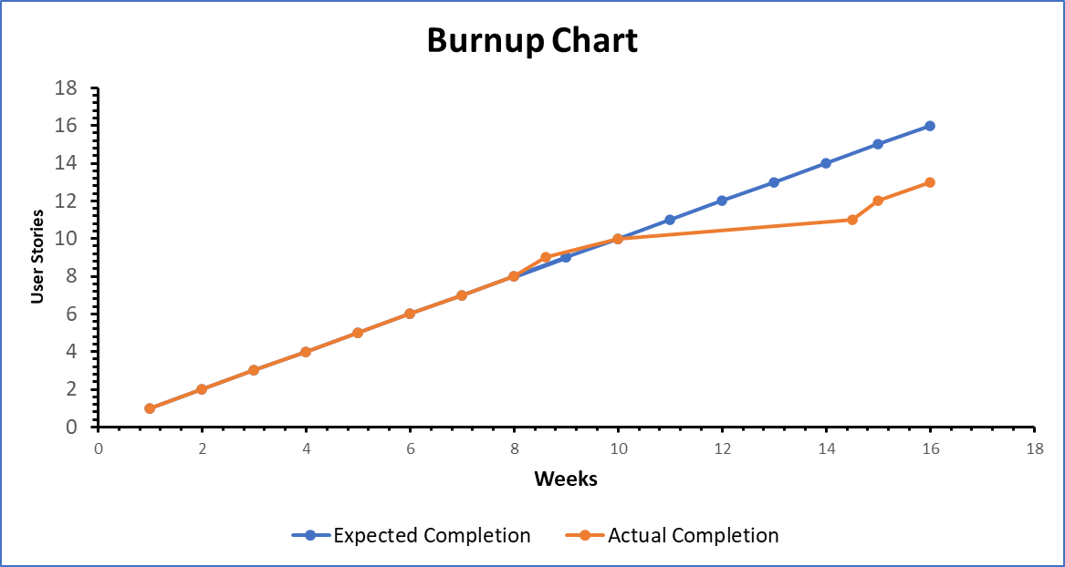
Week 1
Project Planning
Project Management Tools Used
Microsoft excel
Week 2

Slide 6

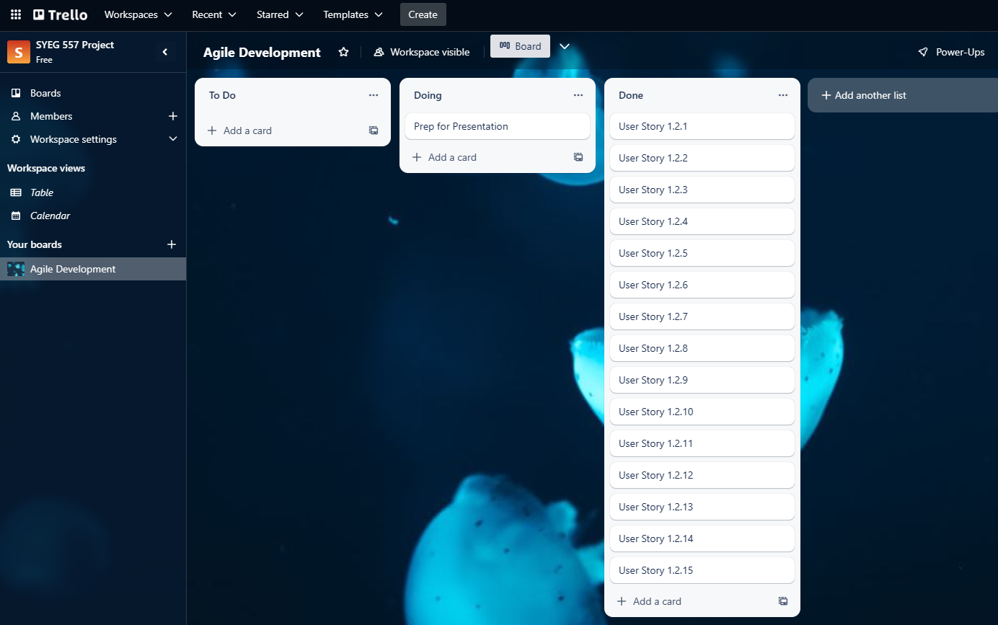
Agile Method - Kanban
Our team practiced the Kanban method of Agile by utilizing Trello

Slide 7
Advantages:
Clear communication tool – As due dates approach, the color of the cards change to yellow
User Friendly / Mobile Friendly App
Notifications when Kanban Cards are updated or moved
Disadvantages:
No history of tracking (if a card moves from 'done' back to 'in-work')
No chat function – Used WhatsApp for messaging
Lack of task dependencies (No Giver-Reciever handoffs)
During our last sprint we began implementing Lean which encouraged more focus on the work vs. talking about the work
Agile Method
Kanban < Lean

Slide 8
ENTER

Slide 9
Challenge 1: Application of WordPress into Scrum
Roles:
Product Owner
Knows exactly what the team needs to build.
"Role can only belong to one person."
Scrum Master
Development team leader; person willing to make decisions.
Scrum Team
People who will perform all the developments tasks necessary to deliver the project.
"Team members can pick what they want."
WordPress:
New software for all team members.
Not all team member are familiar with programming.
SCRUM doesn't feel applicable for a team of 4.

Slide 10
Challenge 2: Scoring Logic
Summary:
25 Questions
Six question each dimension.
One additional question.
Four responses
Strongly Agree, Agree, Disagree, and Strongly Disagree.
Four categories
First, Second, Third, and Fourth.
I and E, S and N, T and F, J and P, respectively.
Type of question would determine point distribution.
Point logic:
I, S, T, and J
≤ 14
E, N, F, and P
> 14
Previous Methods:
Separating each dimension to its own tenth scoring chart.
I (0-10), E (11-20), S (100-110), N (111-120), T(1000-1010), etc...
≤ 10 vs ≤ 14
24
Max
6
Min

Slide 11
Changes Performed During Development
Restructuring
Reassessing child stories after familiarizing ourselves with WordPress.
Sharing results with friends.
Providing percentages of different dimensions proved time consuming.
Real life waterfall application would have required customer permission for waiver. Not applicable for Agile development which permits you to make changes.

Slide 12

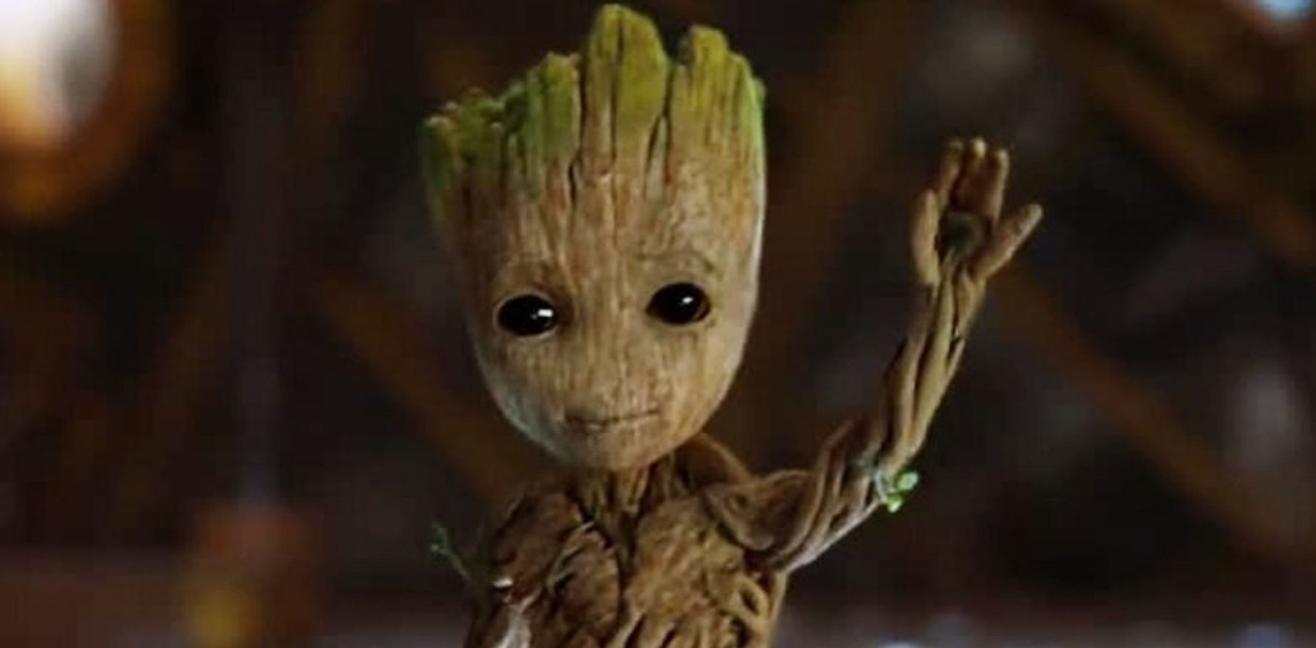
Thank You! Any Questions?

